Slide 1


PhD Course: Copernicus Uptake Use of satellite images for mapping and monitoring the hydrogeological changes in the framework of the A.M.AL.PI.18 Interreg Cooperation Programme
Federica Marotta – 35° cycle
Architecture, Built Environment and Construction Engineering (ABC) dept.
Supervisor: Cristiana Achille Tutor: Marco Scaioni
06 april 2022

Slide 2
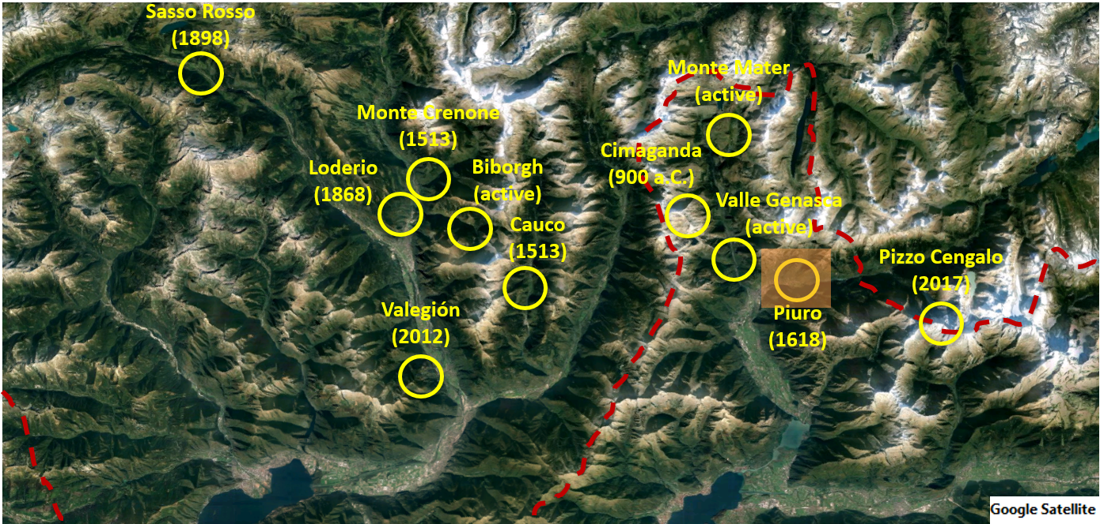
FRAMEWORK

Slide 3
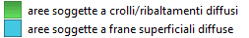
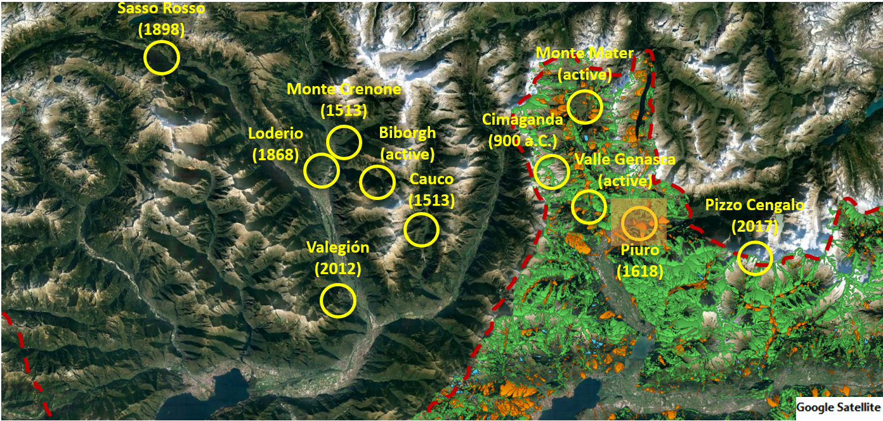
FRAMEWORK
IFFI project reference period: 1116 – 2017

Slide 4




FRAMEWORK
Gotthardpass
Malojapass

Slide 5
GOAL
What: Hydrogeological changes detection
How: Using Sentinel-2 images and a supervised classification technique
General idea: Conducting regular period analyses to reconstruct the evolution of hydrogeological changes in the area of interest
Simplified idea: Use of two images to identify changes in the landscape

Slide 6
Choice of images
QGis
Band Stacking
QGis
Image enhancement
QGis
RStudio
QGis
QGis
Training samples creation
Random Forest Classification
Post-processing of the classified image – Majority filter
Post processing of the classified image - Sieve
Open hub Sentinel 2
METHODOLOGY

Slide 7
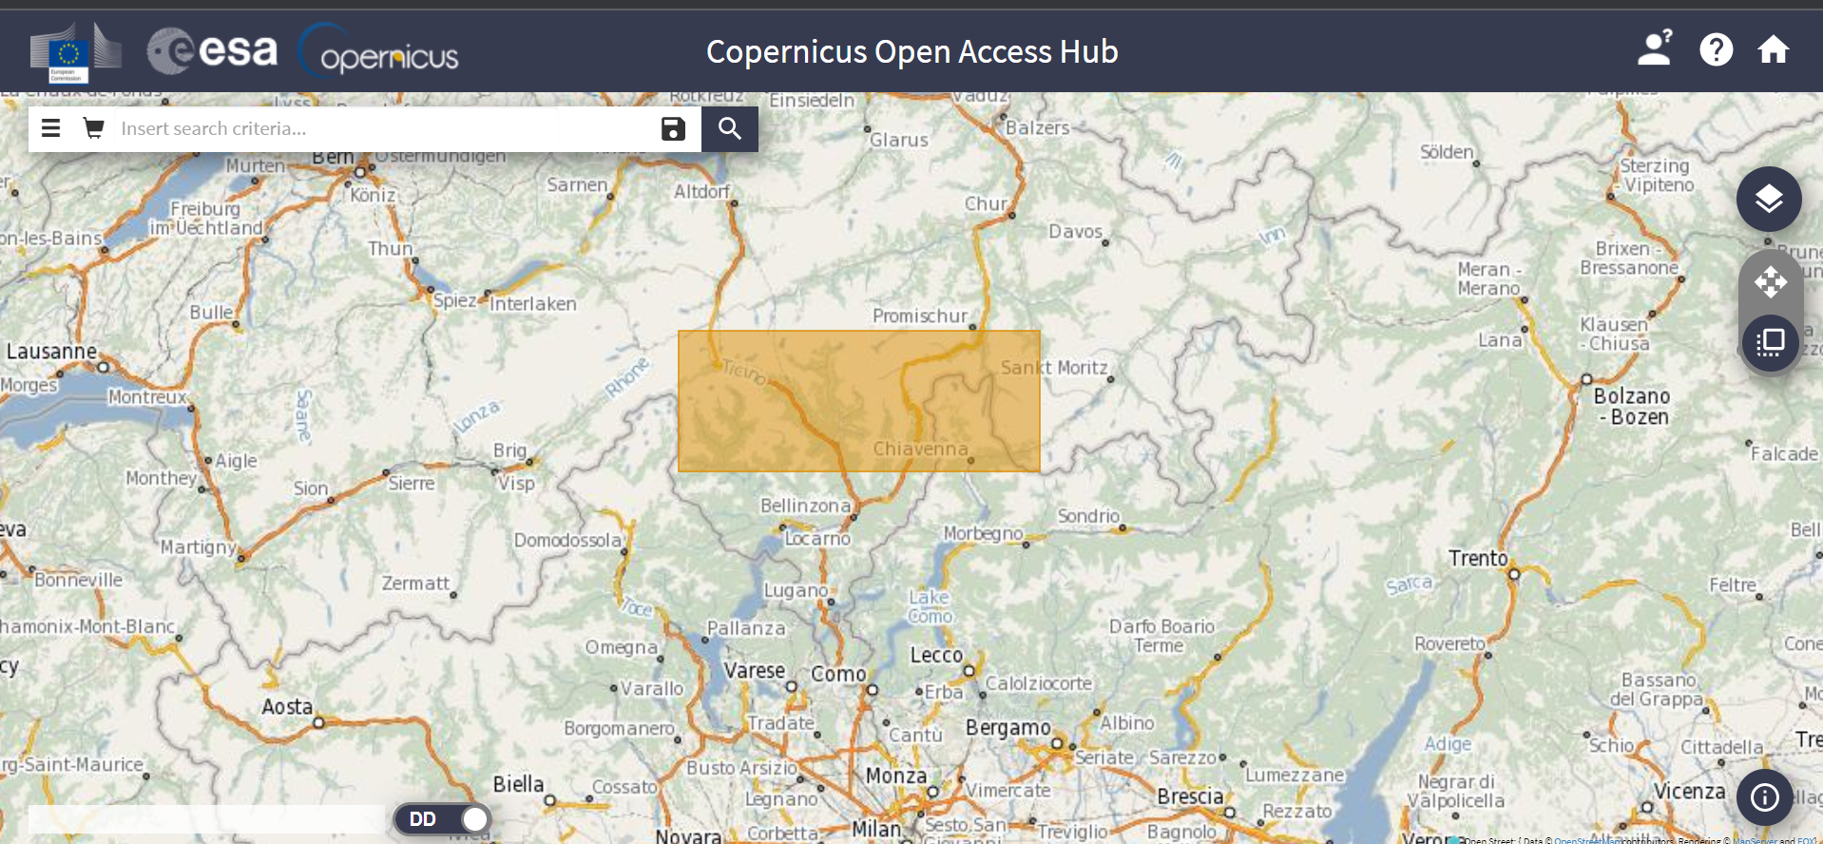
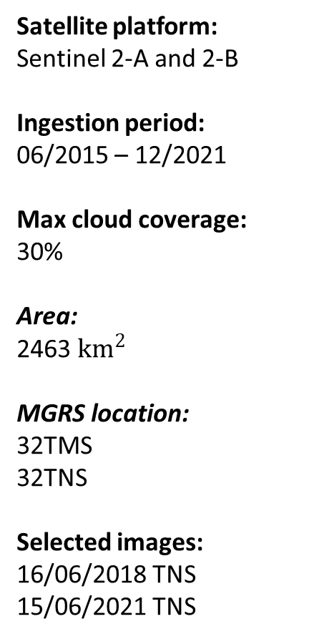
CHOICE OF IMAGES
Satellite platform:
Sentinel 2-A and 2-B
Ingestion period:
06/2015 – 12/2021
Max cloud coverage:
30%
Area:
2463 $km^{2}$
MGRS location:
32TMS
32TNS
Selected images:
16/06/2018 TNS
15/06/2021 TNS

Slide 8
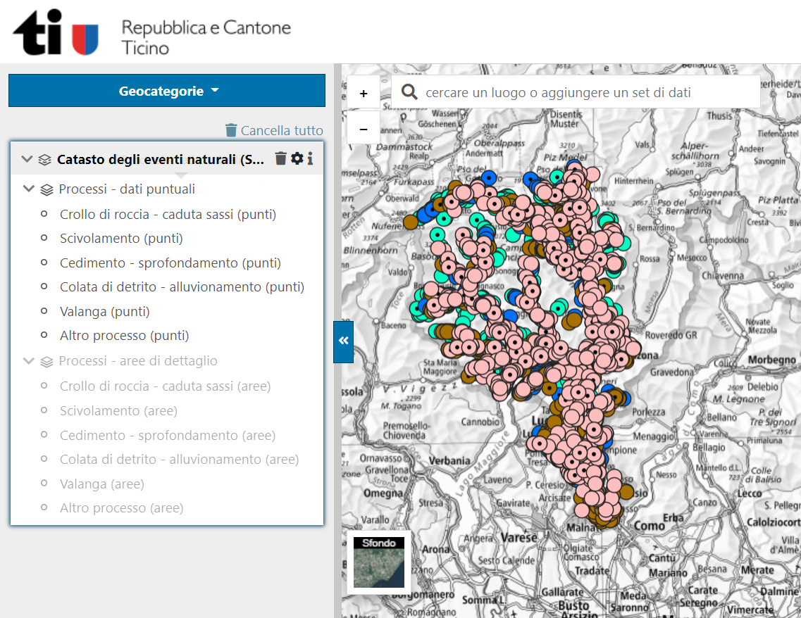
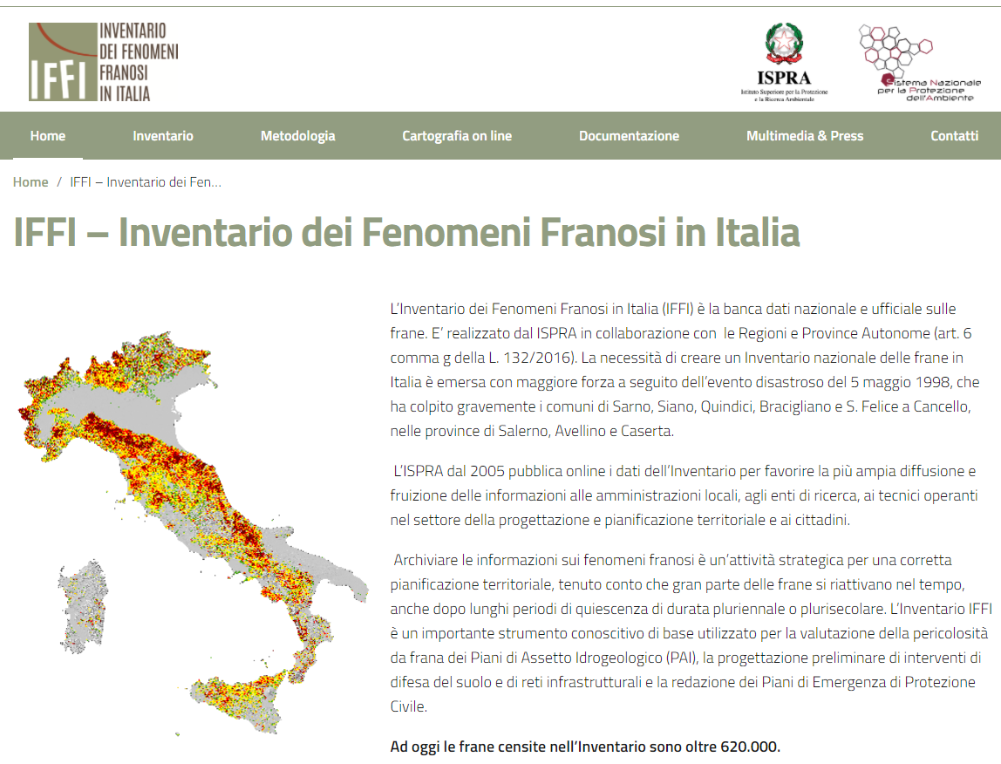
CHOICE OF IMAGES
StorMe – Catasto degli eventi naturali Cantone Ticino
IFFI – Inventario dei Fenomeni Franosi in Italia

Slide 9
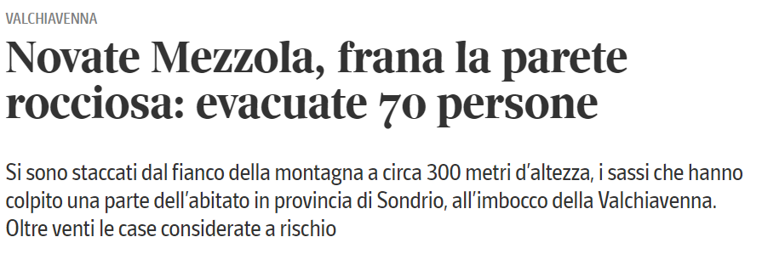
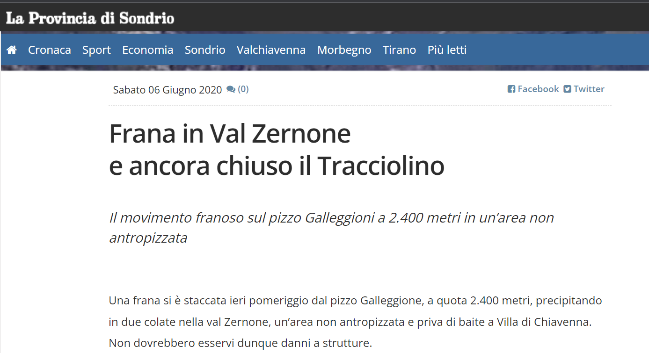
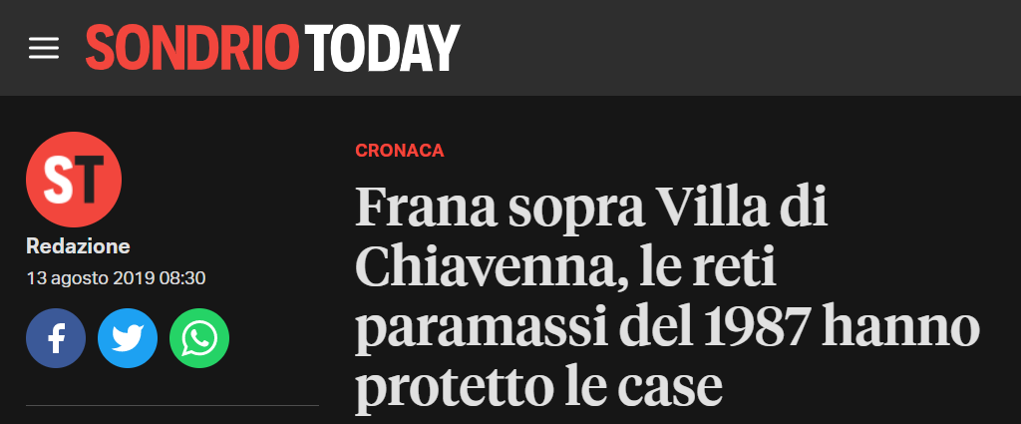
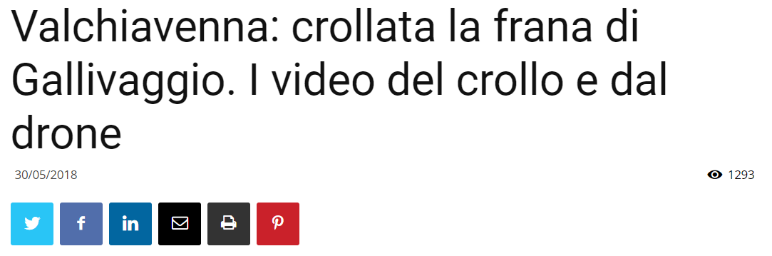
CHOICE OF IMAGES

Slide 10

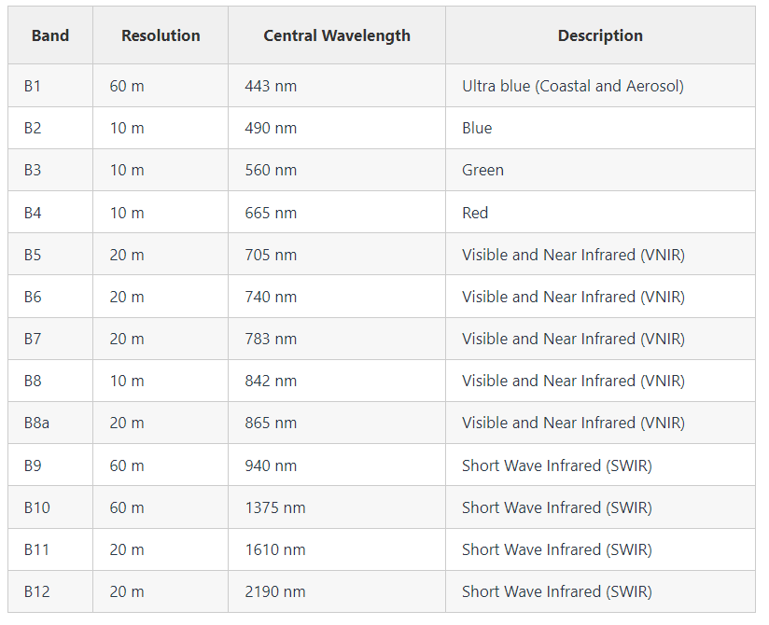
BAND STACKING
v. 3.16.16
16/06/2018 TNS
15/06/2021 TNS
1
2
3
4
5
6
7
8
11
12
13
14
15
16
17
18
+
9
10
19
20

Slide 11
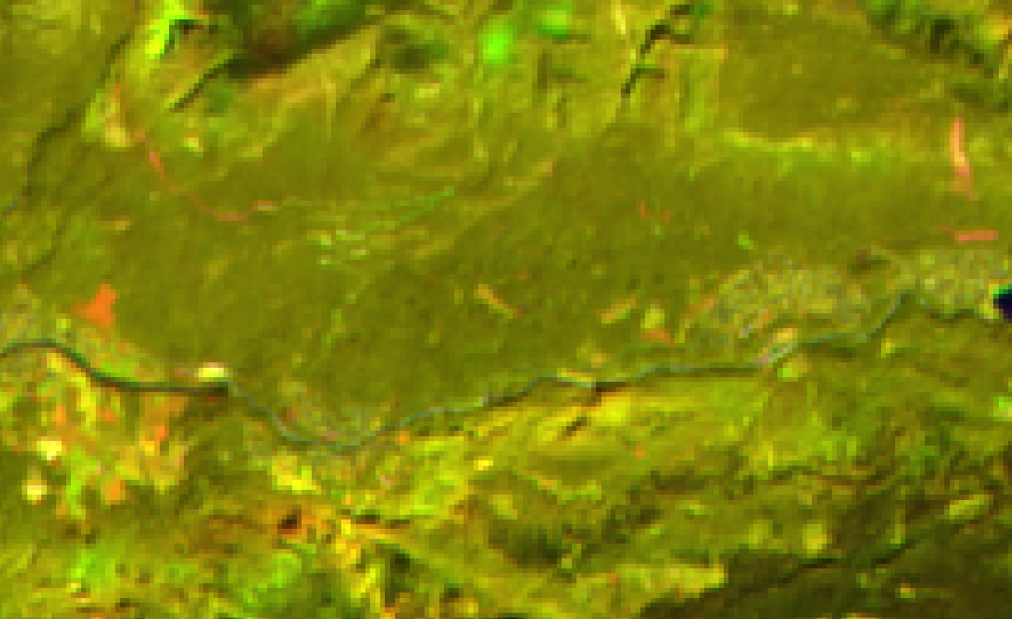
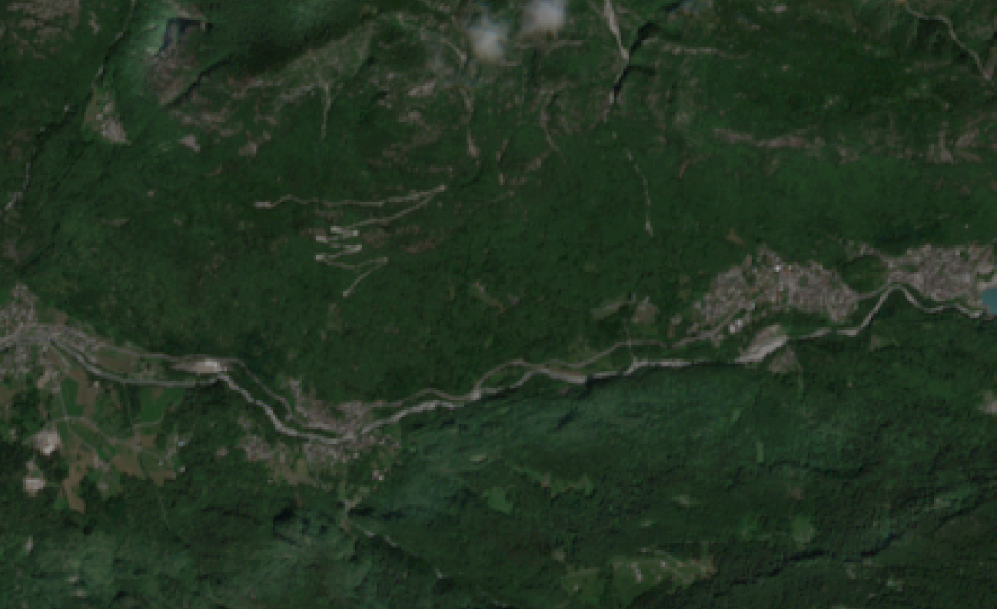
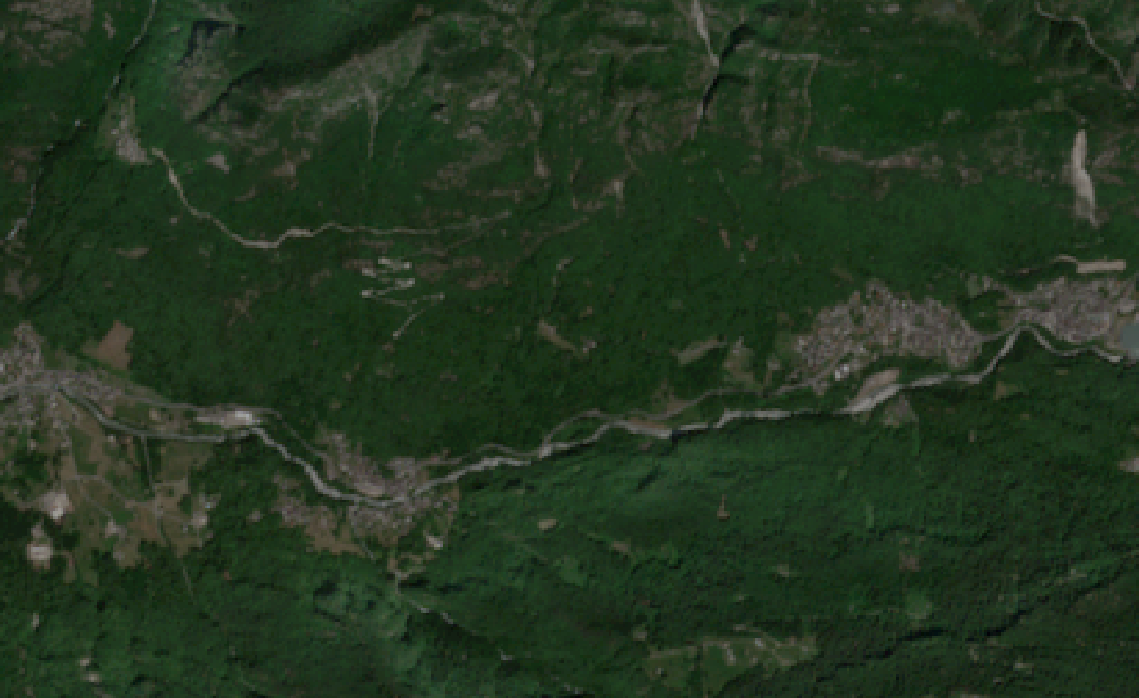
IMAGE ENHANCEMENT
* Date 1= 16/06/2018
Date 2= 15/06/2021
v. 3.16.16
Multi-temporal false color composite:
Red band: Band 19 (SWIR1 – date 2*)
Green band: Band 9 (SWIR1 – date 1)
Blue band: Band 11 (Blue – date 2)
Creation of Savogno road
New cultivated field
Date 1
Date 2

Slide 12
IMAGE ENHANCEMENT
v. 3.16.16
Multi-temporal false color composite:
Red band: Band 19 (SWIR1 – date 2)
Green band: Band 9 (SWIR1 – date 1)
Blue band: Band 11 (Blue – date 2)
Villa di Chiavenna landslide (2019)
Date 1
Date 2

Slide 13
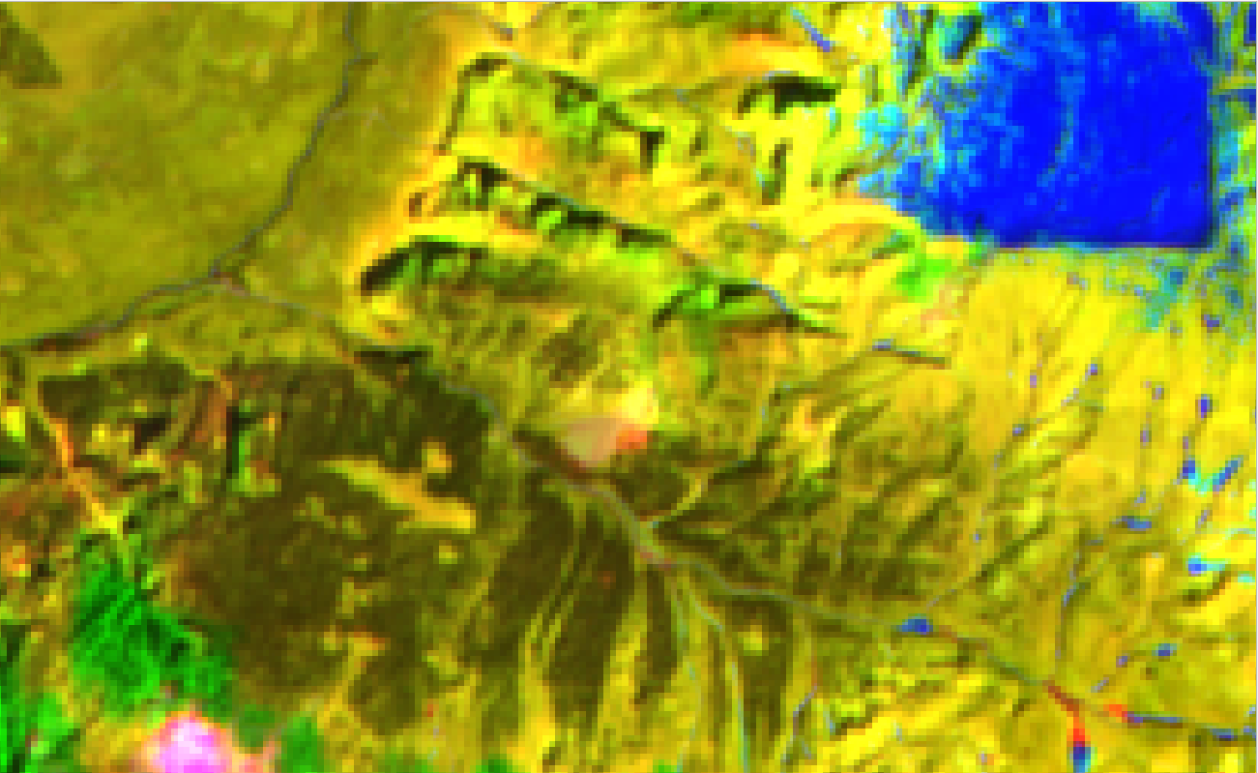
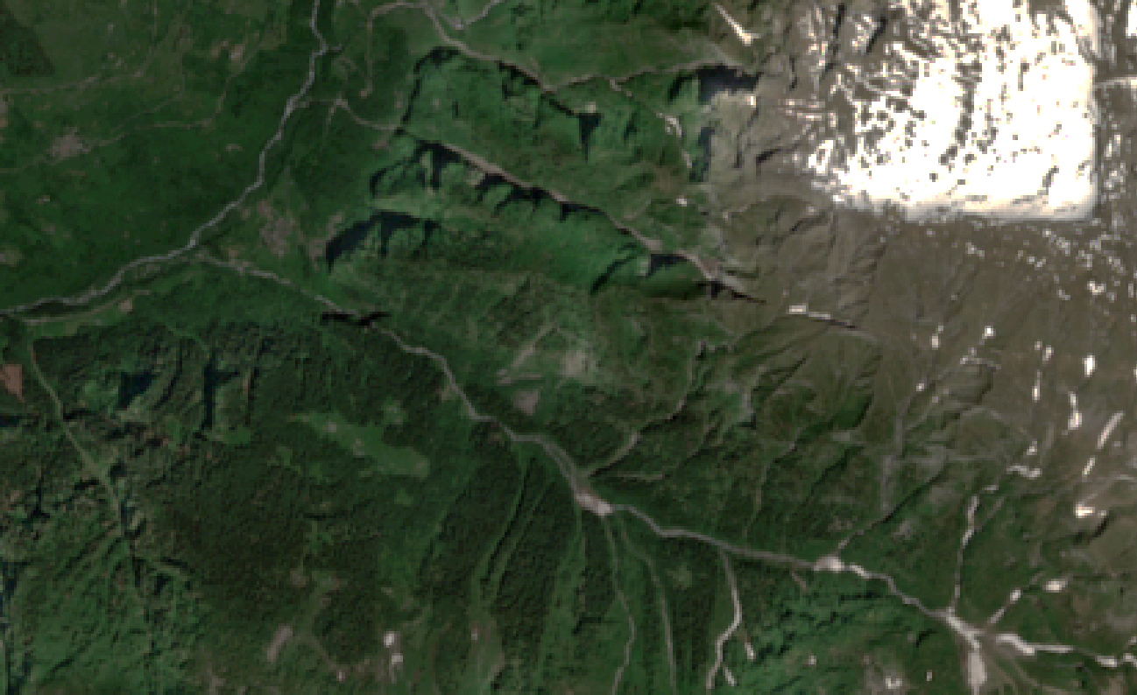
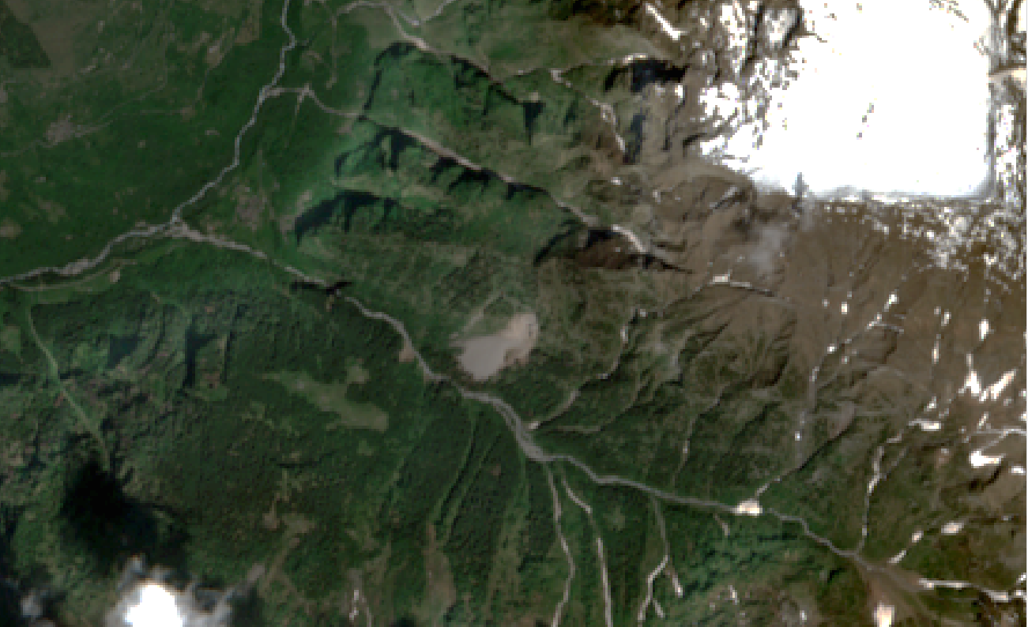
IMAGE ENHANCEMENT
v. 3.16.16
Multi-temporal false color composite:
Red band: Band 19 (SWIR1 – date 2)
Green band: Band 9 (SWIR1 – date 1)
Blue band: Band 11 (Blue – date 2)
Val Madra landslide
Date 1
Date 2

Slide 14
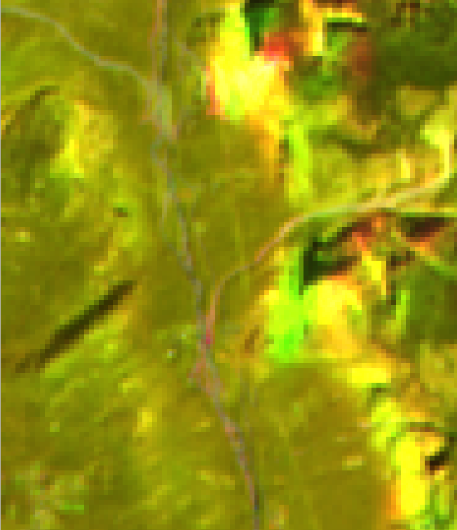
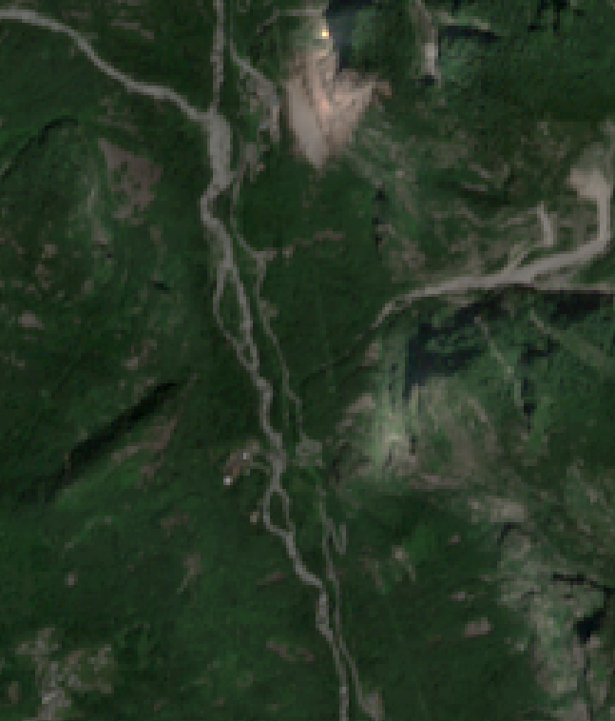
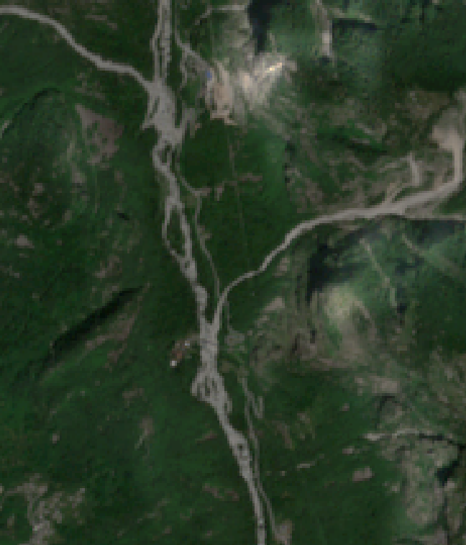
IMAGE ENHANCEMENT
v. 3.16.16
Multi-temporal false color composite:
Red band: Band 19 (SWIR1 – date 2)
Green band: Band 9 (SWIR1 – date 1)
Blue band: Band 11 (Blue – date 2)
Gallivaggio rockfall (2018)
Lesina stream flood (2019)
Date 1
Date 2

Slide 15
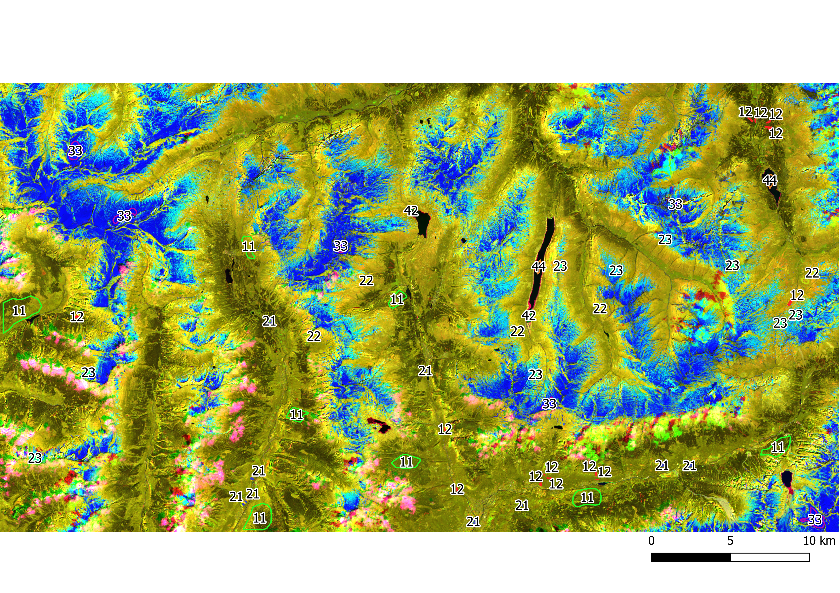
TRAINING SAMPLES CREATION
v. 3.16.16
Class | N. Samples
11 | 8
12 | 13
21 | 9
22 | 5
23 | 9
33 | 6
42 | 2
44 | 2

Slide 16

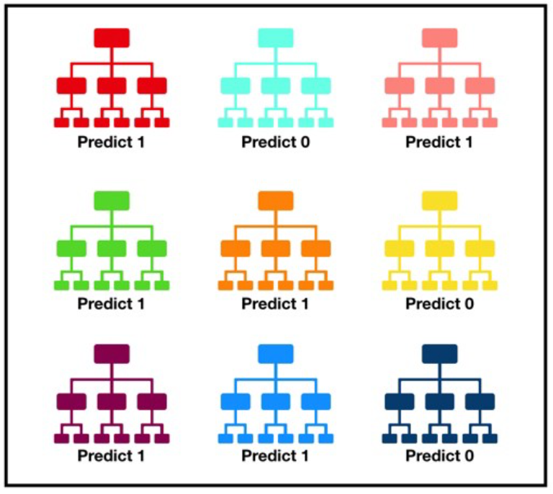
RANDOM FOREST CLASSIFICATION ALGORITHM
v. 4.1.2
Decision tree:
«What feature will allow me to split the observations at hand in a way that the resulting groups are as different from each other as possible (and the members of each resulting subgroup are as similar to each other as possible)?»
Random Forest:
a large number of individual decision trees that operates as an ensemble

Slide 17
RANDOM FOREST CLASSIFICATION ALGORITHM
v. 4.1.2
The script was written by Ned Horning [horning@amnh.org]
Support for writing and maintaining this script comes from The John D. and
Catherine T. MacArthur Foundation and Google.org.
The script was modified by Amber McCullum: NASA ARSET
Approximate number of training samples to be randomly selected for running the Random Forest algorithm:
100 for each class
Processing time: 6.83 min

Slide 18
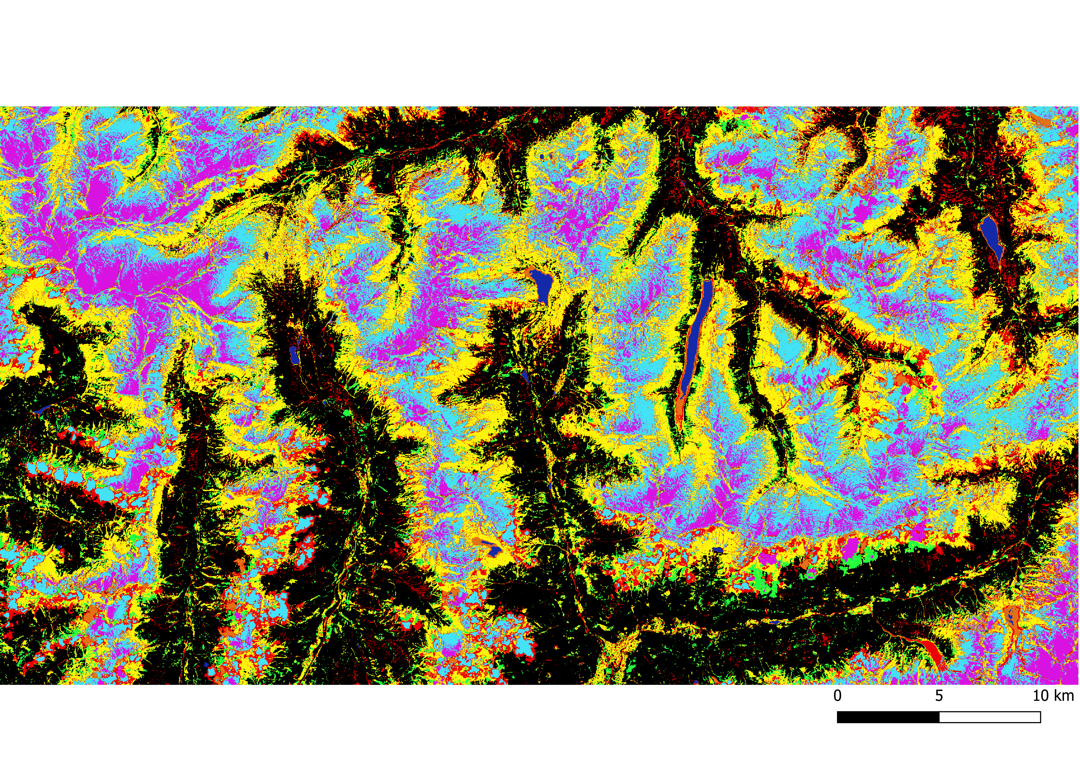
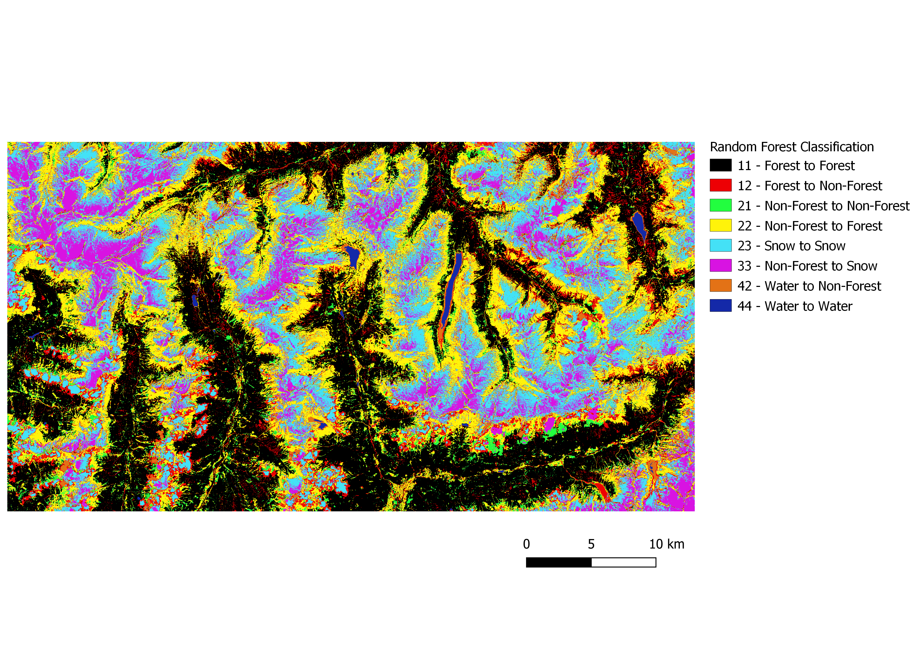
RANDOM FOREST CLASSIFICATION ALGORITHM
v. 4.1.2

Slide 19
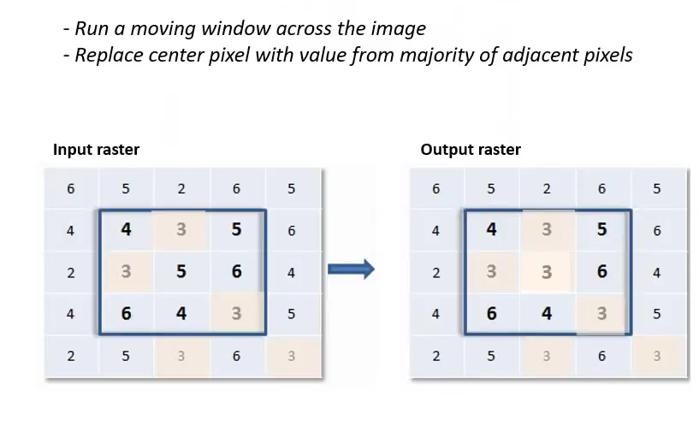
POST PROCESSING – MAJORITY FILTER
v. 3.16.16
Aim of the filter: to remove speckles and noise
Operation method:

Slide 20
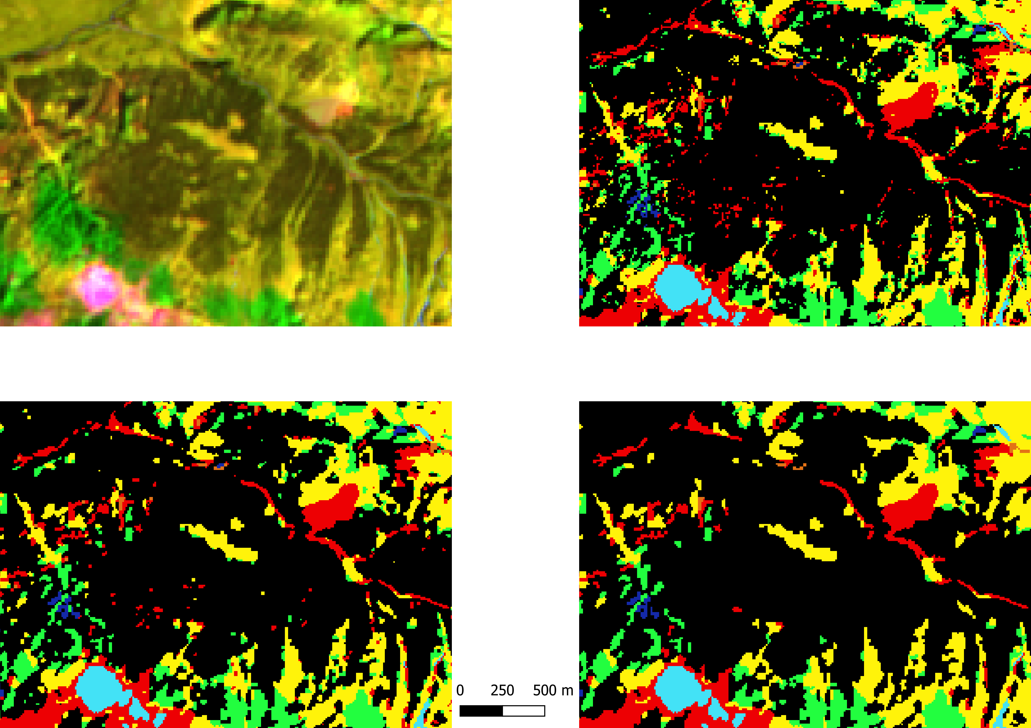
POST PROCESSING – MAJORITY FILTER
v. 3.16.16
Stacked
No filter
Majority filter 3x3
Majority filter 5x5

Slide 21
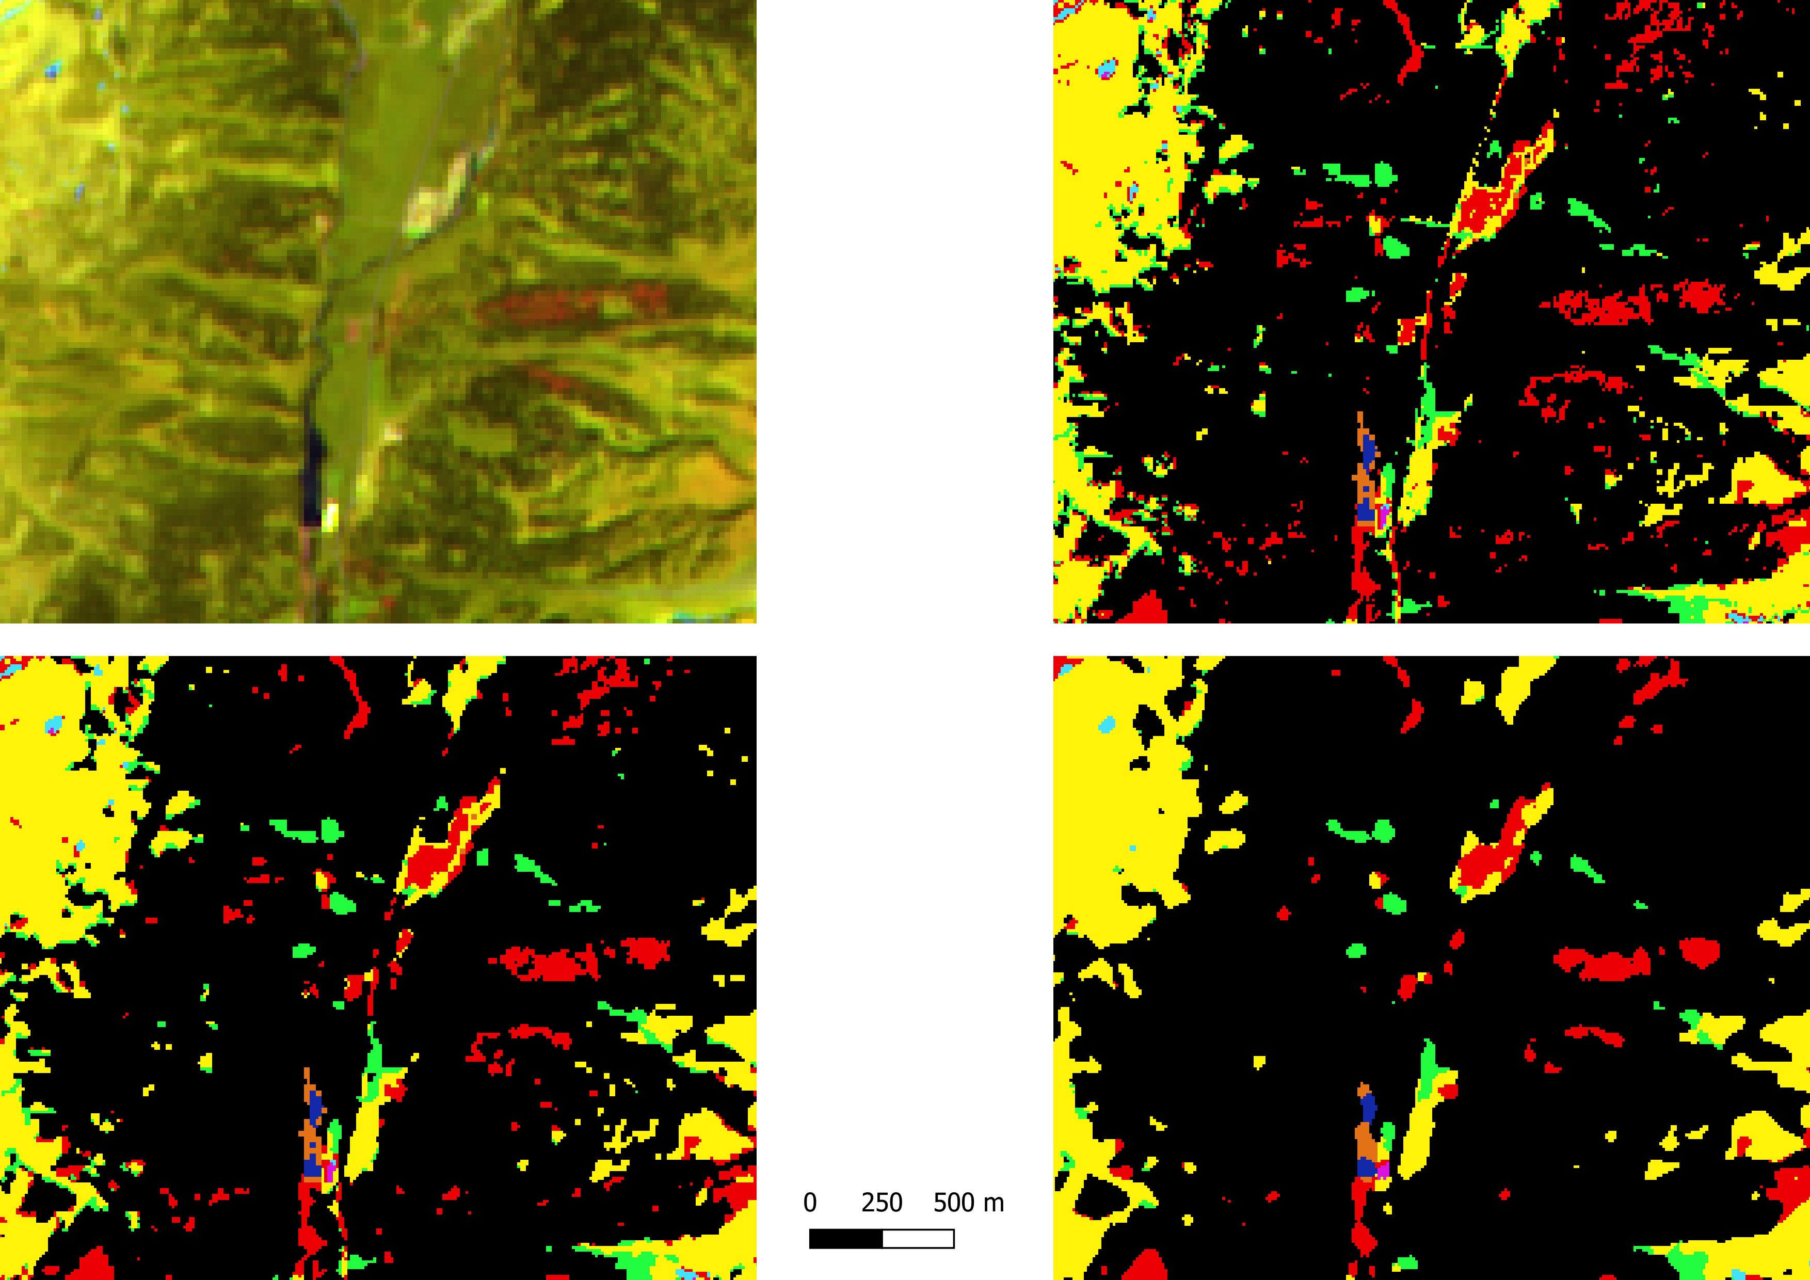
POST PROCESSING – MAJORITY FILTER
v. 3.16.16
Stacked
No filter
Majority filter 3x3
Majority filter 5x5

Slide 22
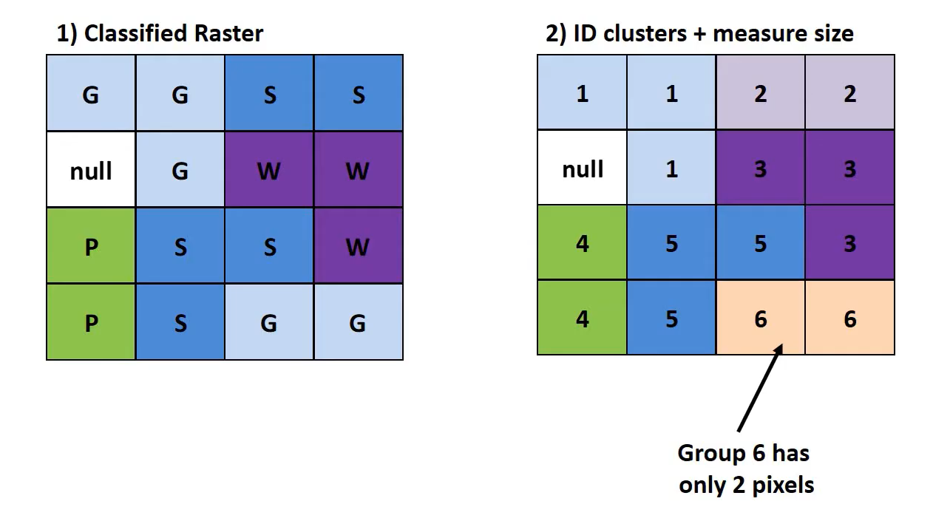
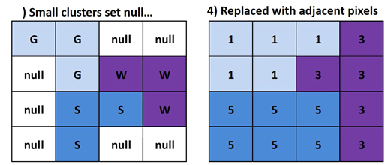
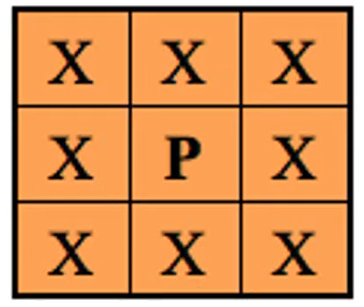
POST PROCESSING – SIEVE
v. 3.16.16
Aim of the algorithm: to remove small clumps of pixels incorrectly classified:
e.g., removal of group of pixels smaller than 3
3
..Replace them with the pixel value of the largest neighbour polygon
Set the 8-connectedness and threshold = 10 (default)

Slide 23
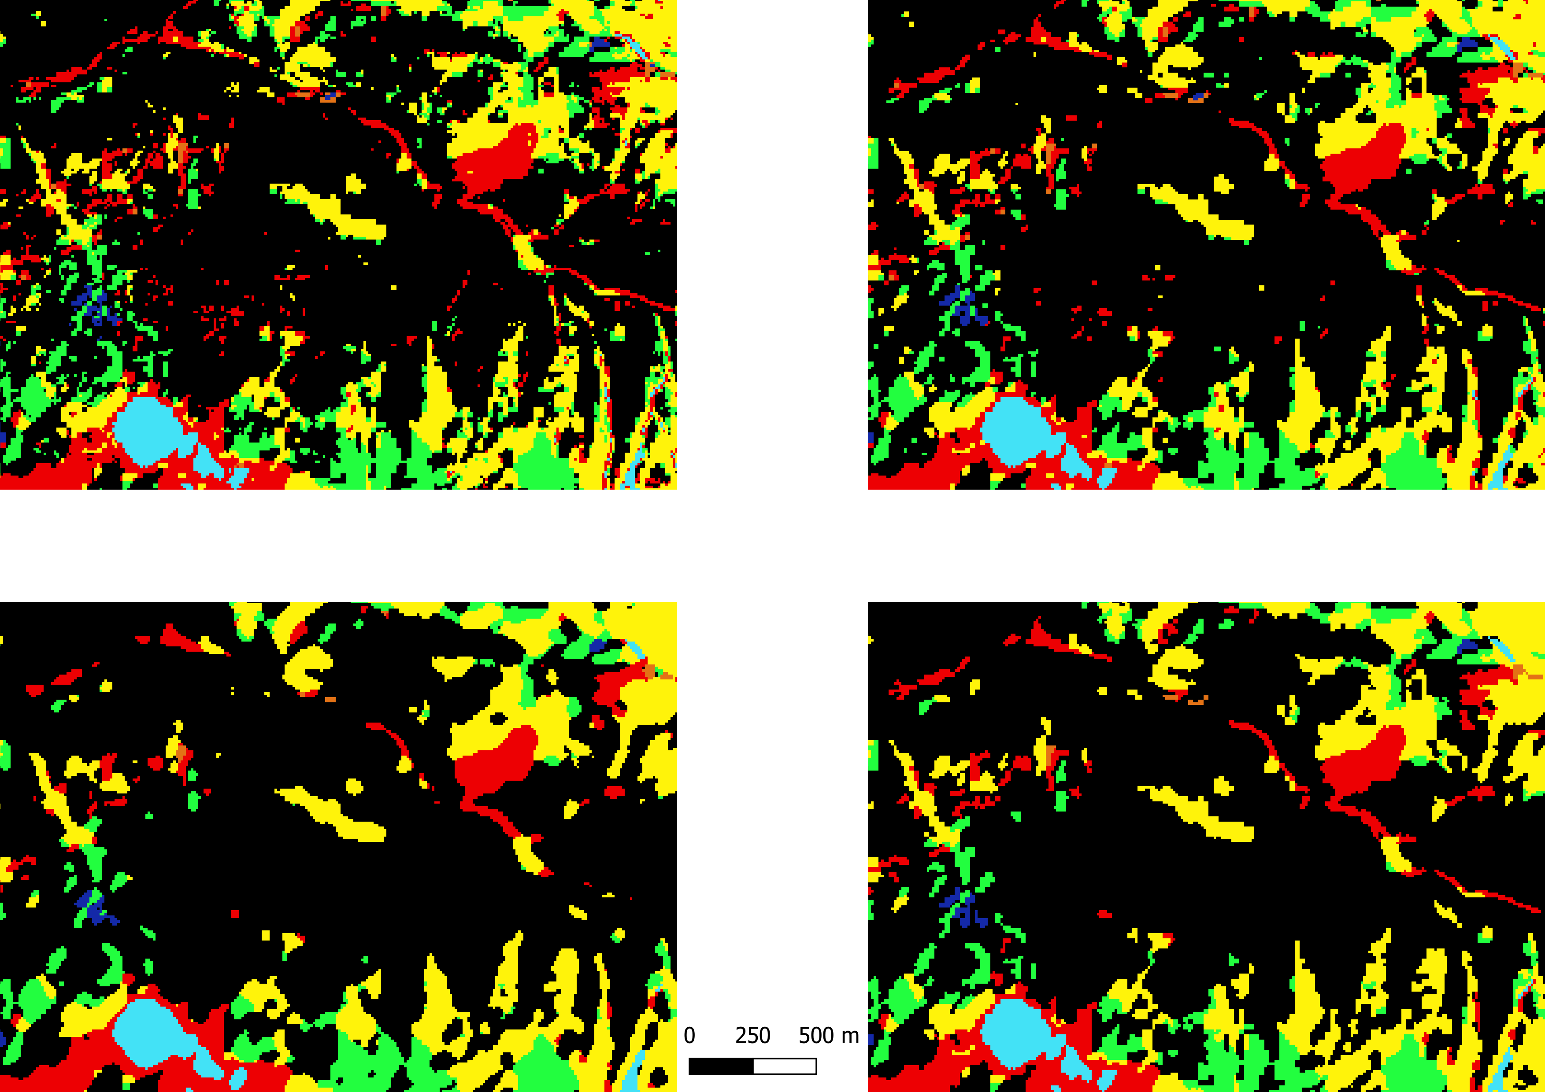
POST PROCESSING – SIEVE
v. 3.16.16
No filter
Majority filter 3x3
Majority filter 5x5
Majority filter 3x3
+
Sieve

Slide 24
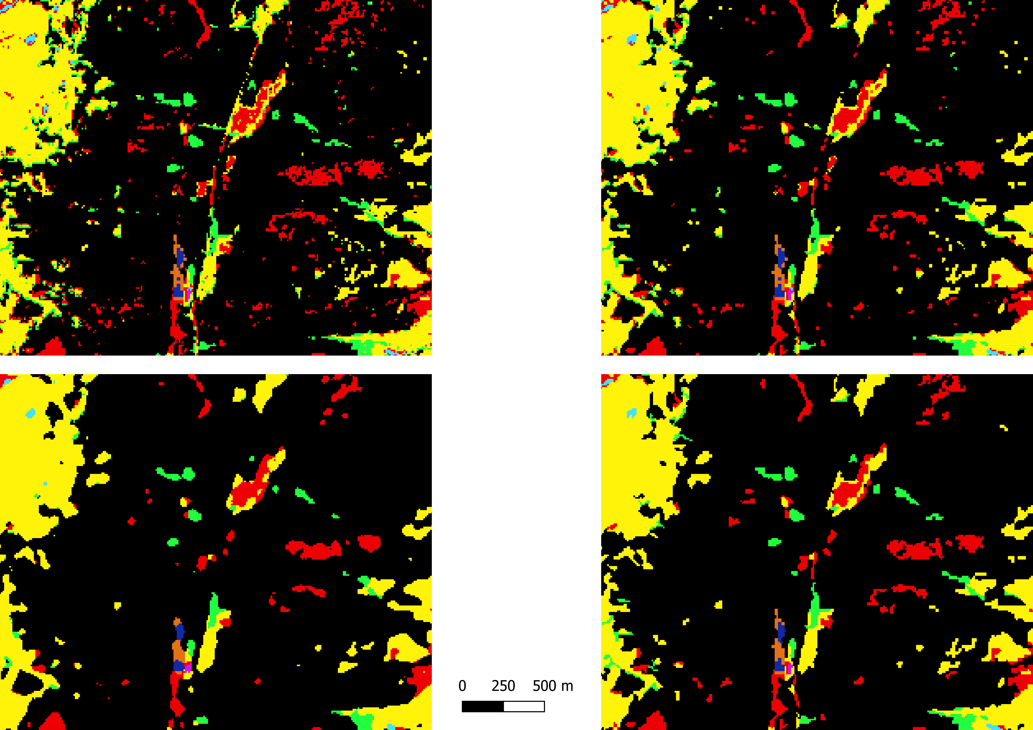
POST PROCESSING – SIEVE
v. 3.16.16
No filter
Majority filter 3x3
Majority filter 5x5
Majority filter 3x3
+
Sieve

Slide 25
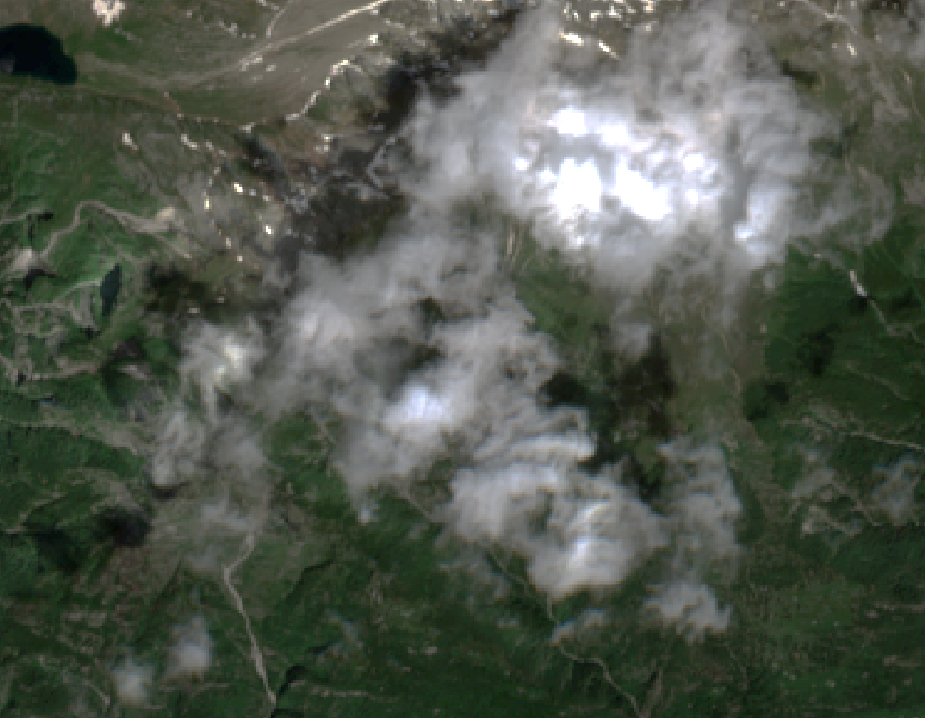
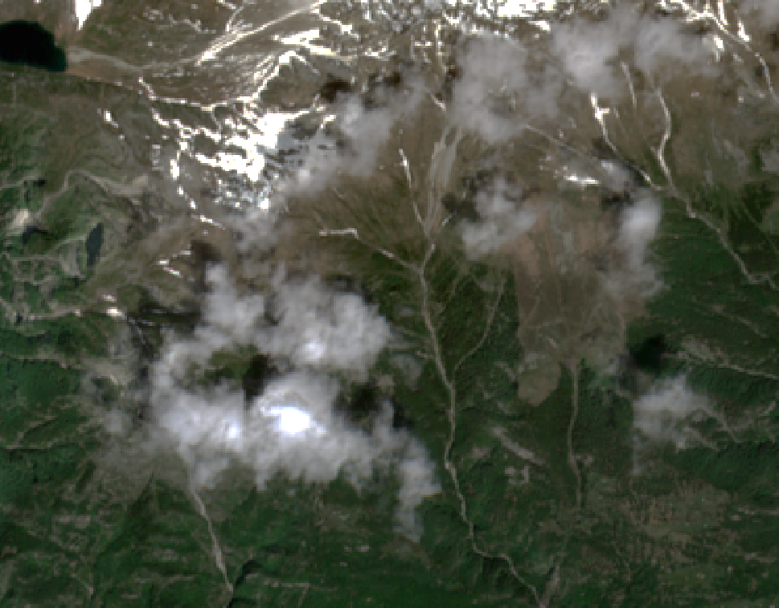
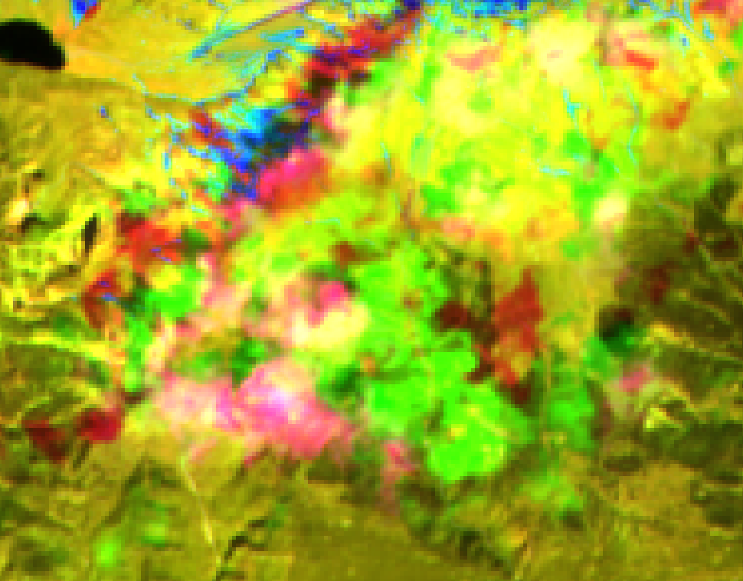
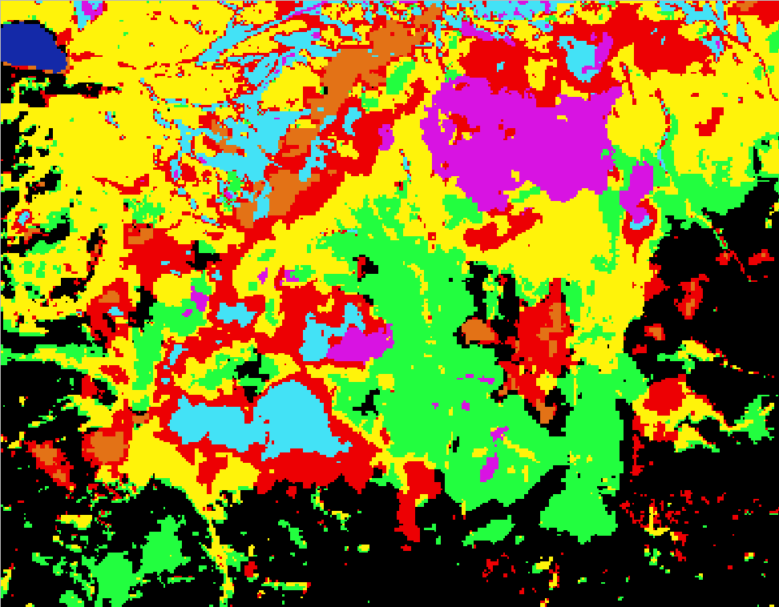
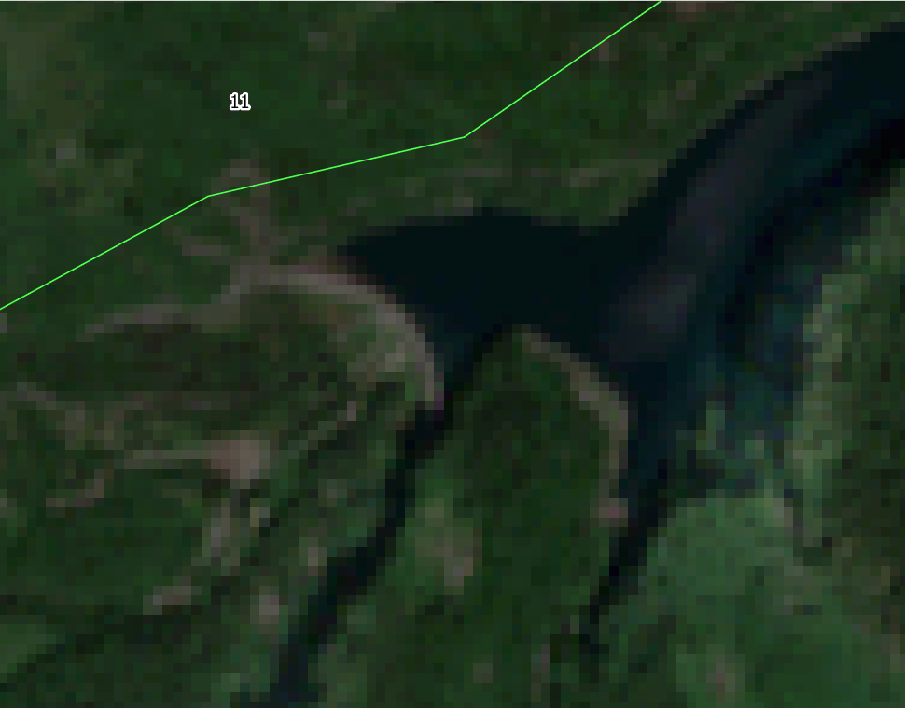
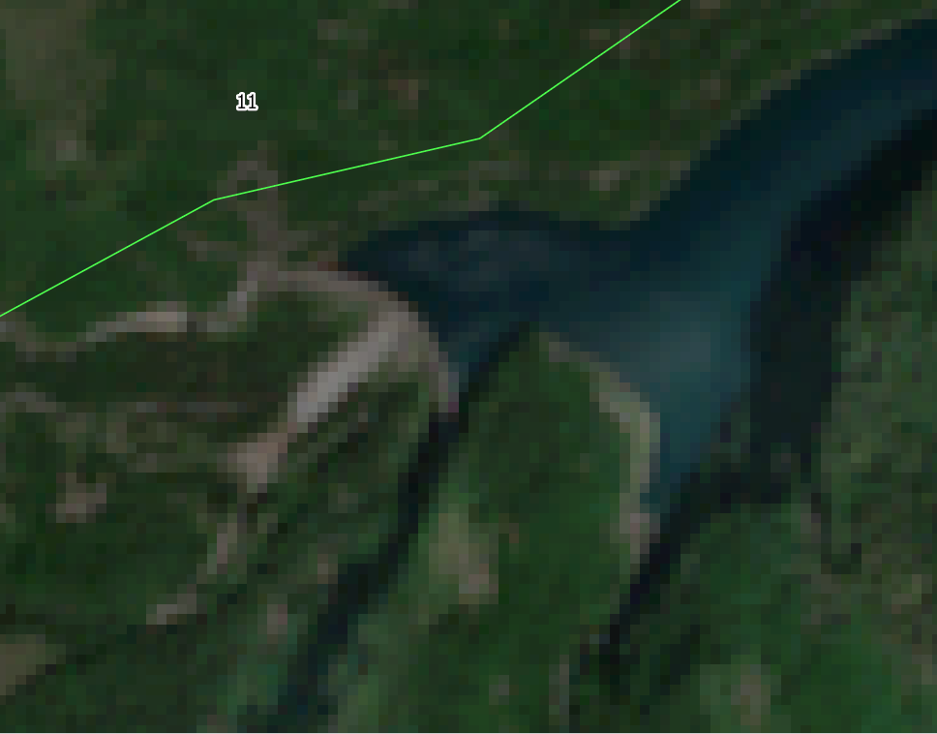
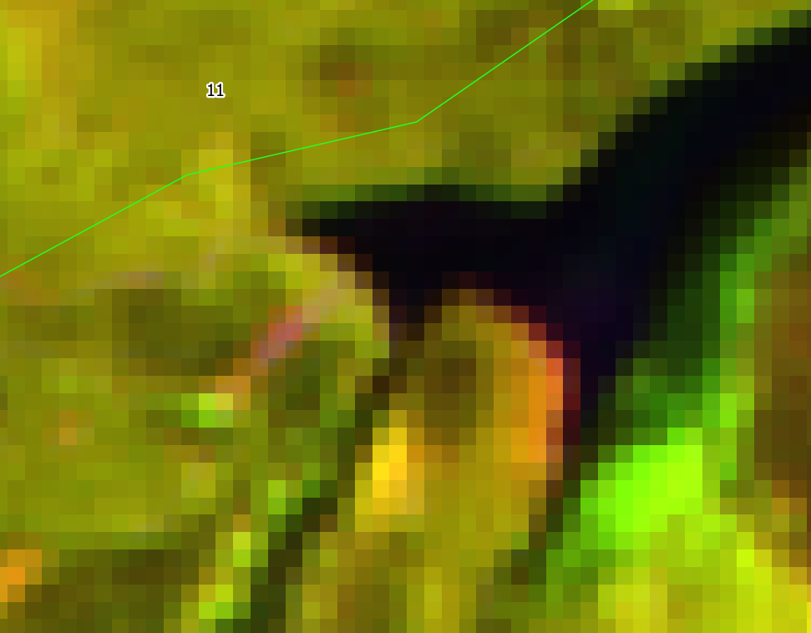
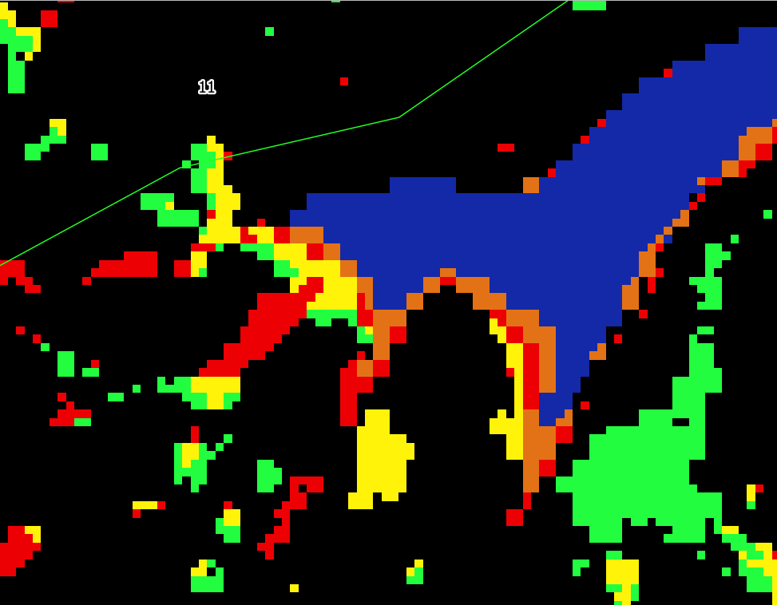
DISCUSSION – QUALITATIVE ANALYSIS
The presence of clouds generates confusion in the classification
2018
2021
The same vegetated area, in different light conditions, gives rise to a «non forest to non forest» incorrect classification
2018
2021

Slide 26
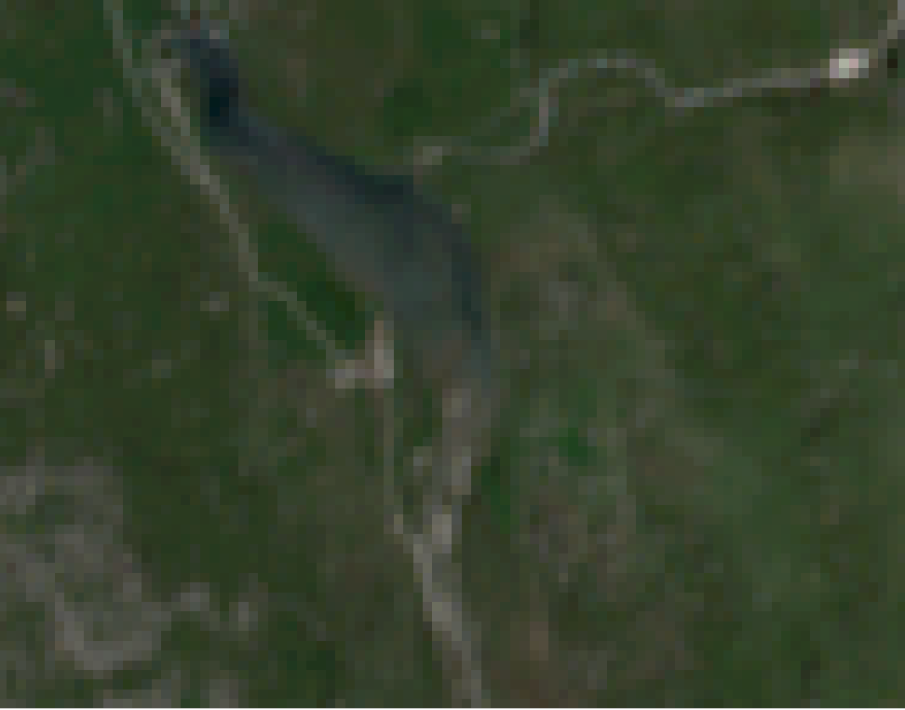
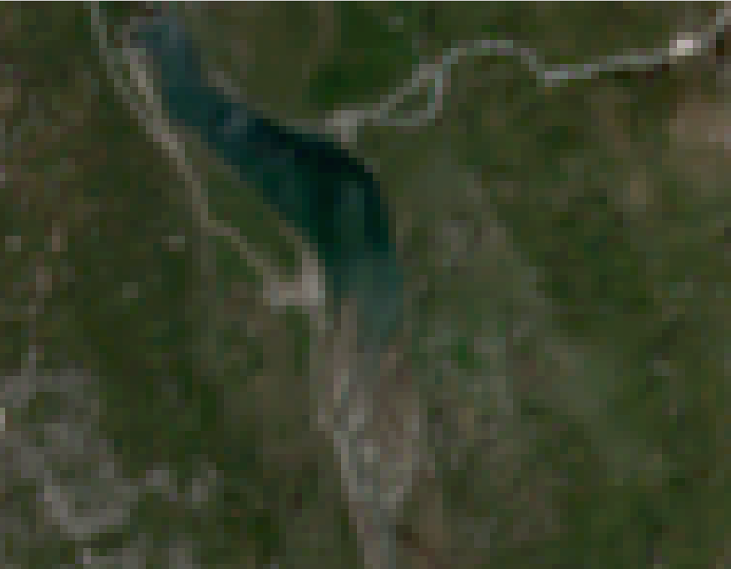
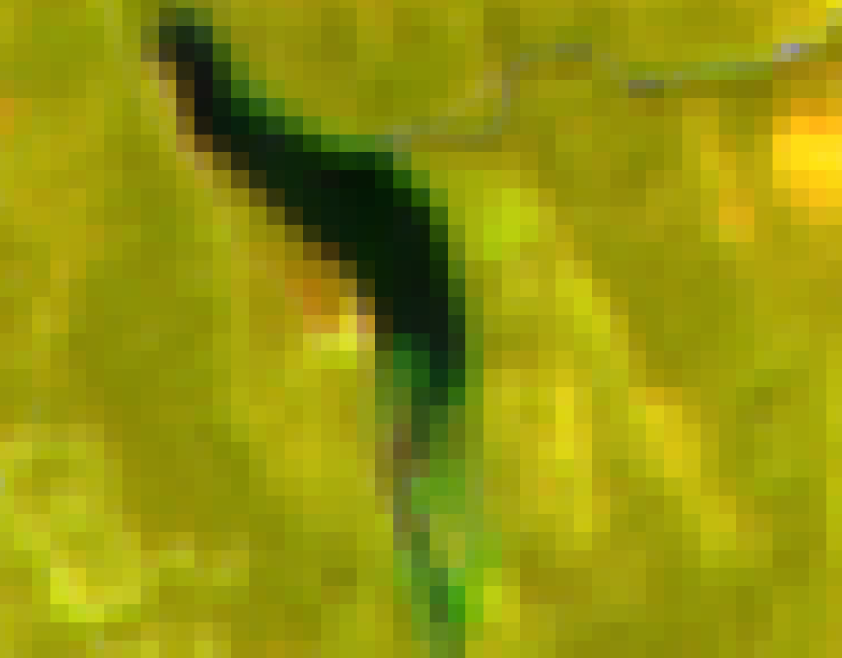
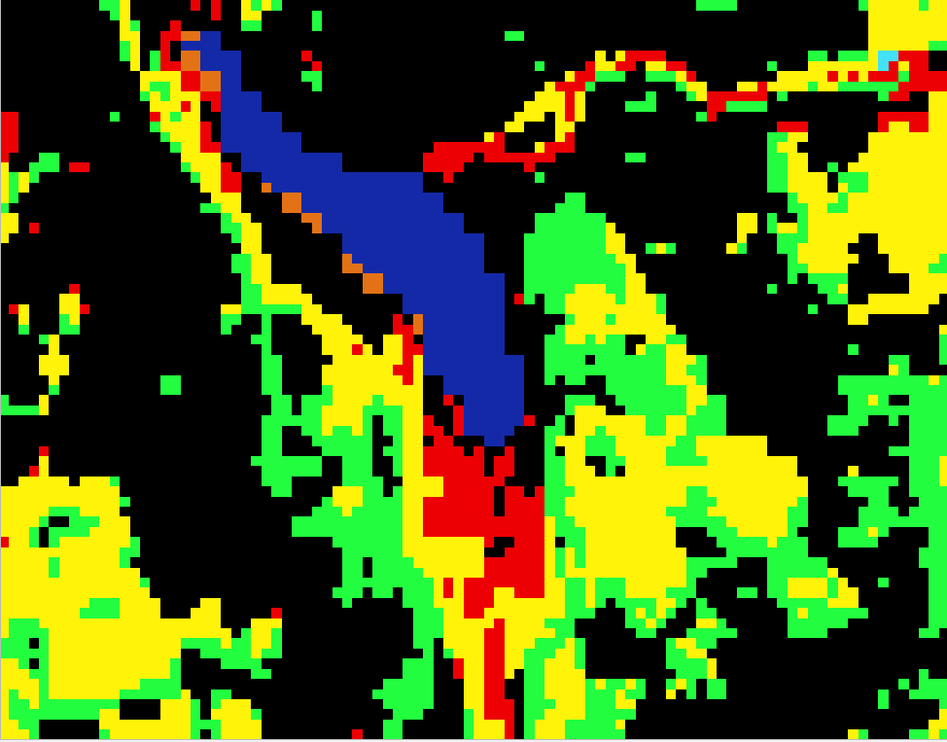
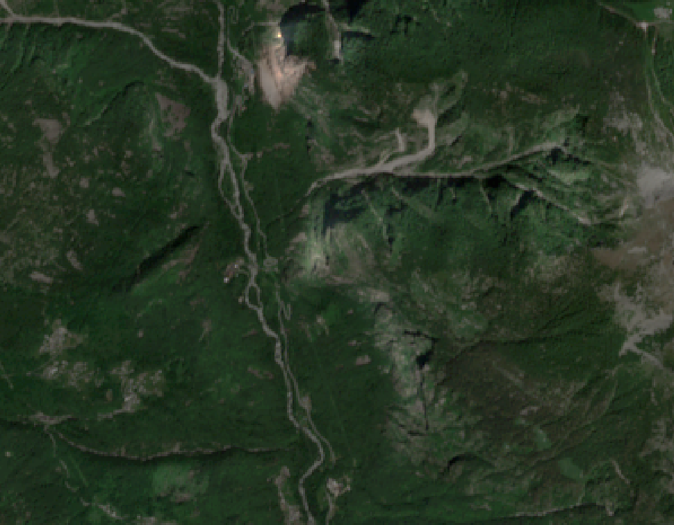
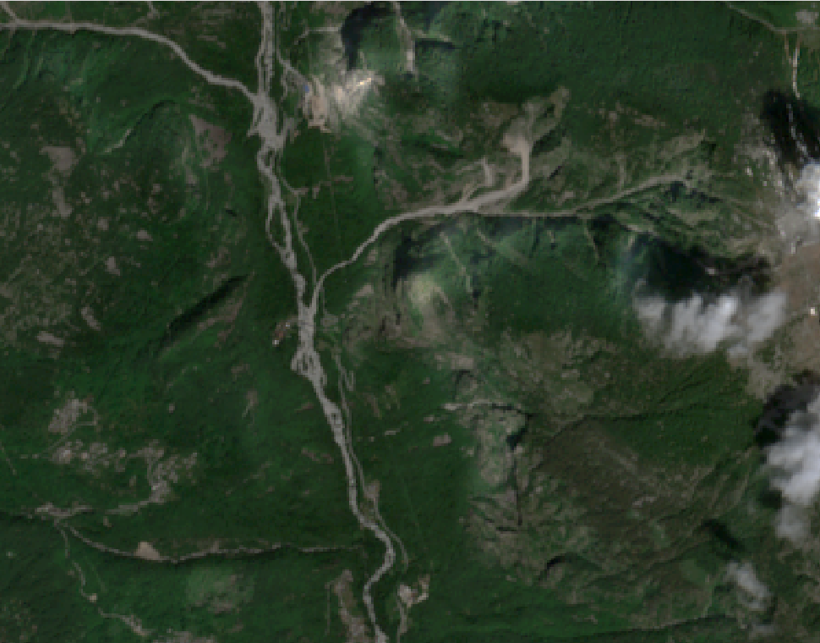
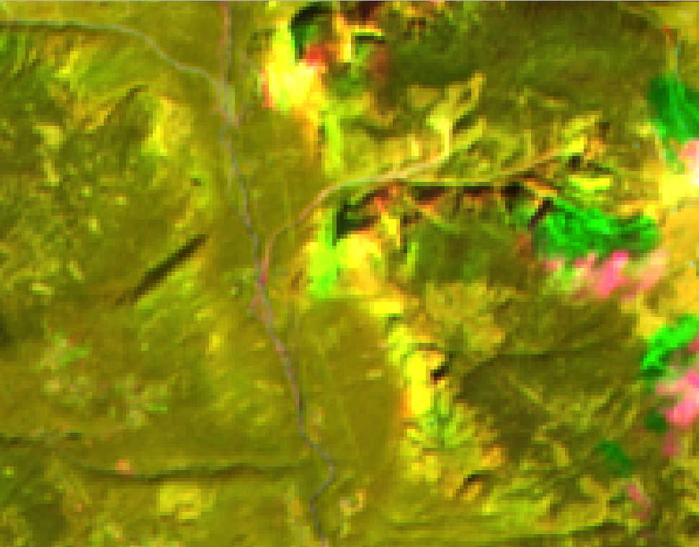
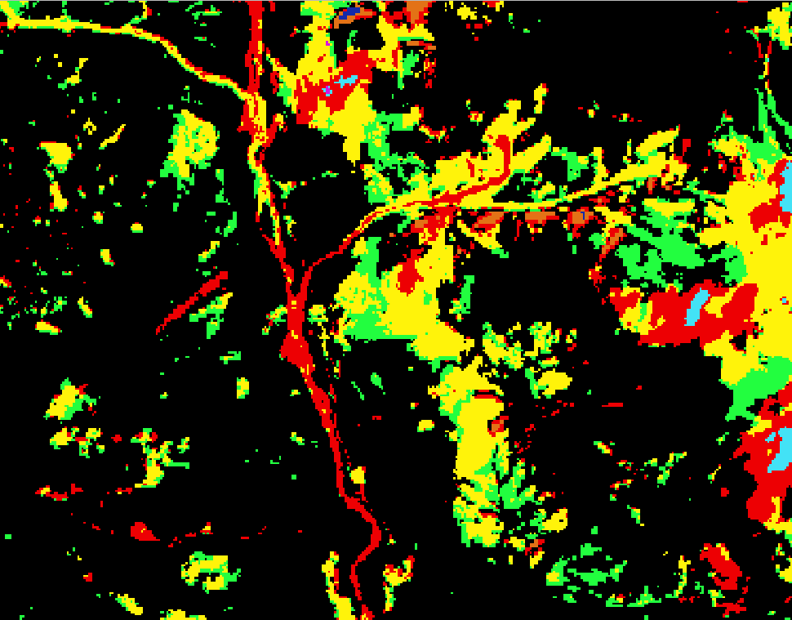
DISCUSSION – QUALITATIVE ANALYSIS
«Forest to non forest» changes (red) are quite well detected but little bit overestimated
2018
2021
2018
2021

Slide 27
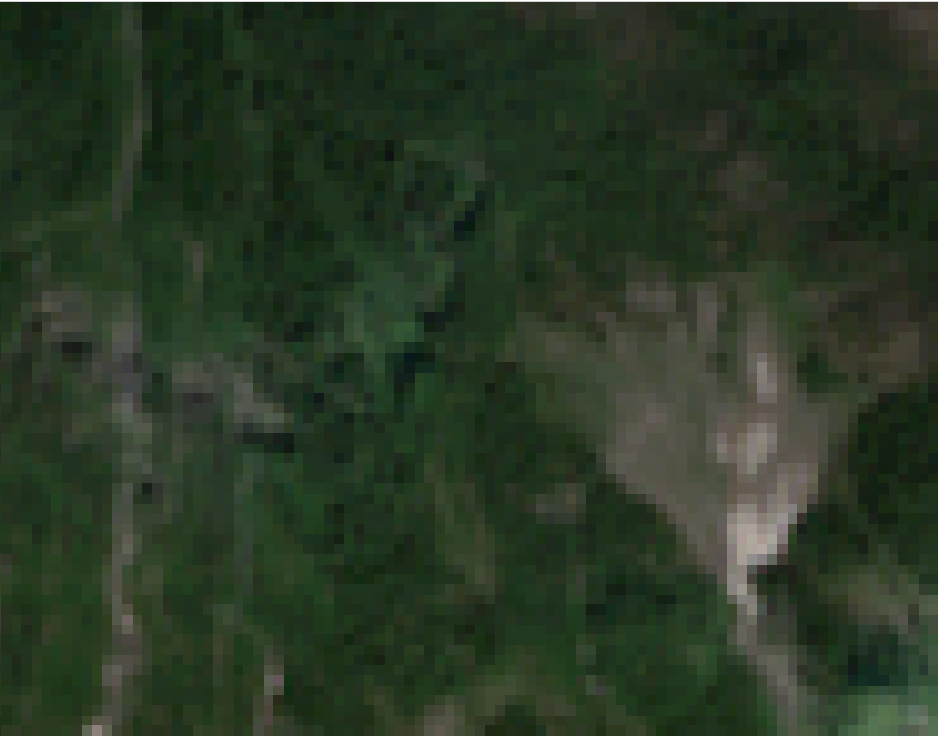







DISCUSSION – QUALITATIVE ANALYSIS
«Non forest to forest» (yellow) and «non forest to non forest» (green) show general error in the classification
2018
2021
For - For
Non For - Non For
For - Non For
Non For - For

Slide 28

FUTURE WORKS
Clouds removal to perform a more precise classification
Choice of images with < cloud coverage to perform a better classification
Change the approximate number of training samples to be randomly selected for running the Random Forest algorithm
Try to add/remove classes to the classification
Try to classify a 21 stacked bands raster (${21}^{st}$: NDVI2021-NDVI2018)
Try the three different supervised classification in Qgis environment (SCP plugin)
Perform a validation of the classification

Slide 29


FAR FUTURE WORKS
Mobile GIS in support of Copernicus EMS
Use of Qfield and Input app to map in real time changes occured in the environment

Slide 30
Thank you!

